Slide 1

BATIK TYPE CLASSIFICATION USING MACHINE LEARNING BASED APPLICATION
Advisors 1
Nur Ibrahim, S.T., M.T.
Advisors 2
R Yunendah Nur Fu’adah, S.T., M.T.
Advisors 3
Nor KumalasariCaecar Pratiwi, S.T., M.T.

Slide 2

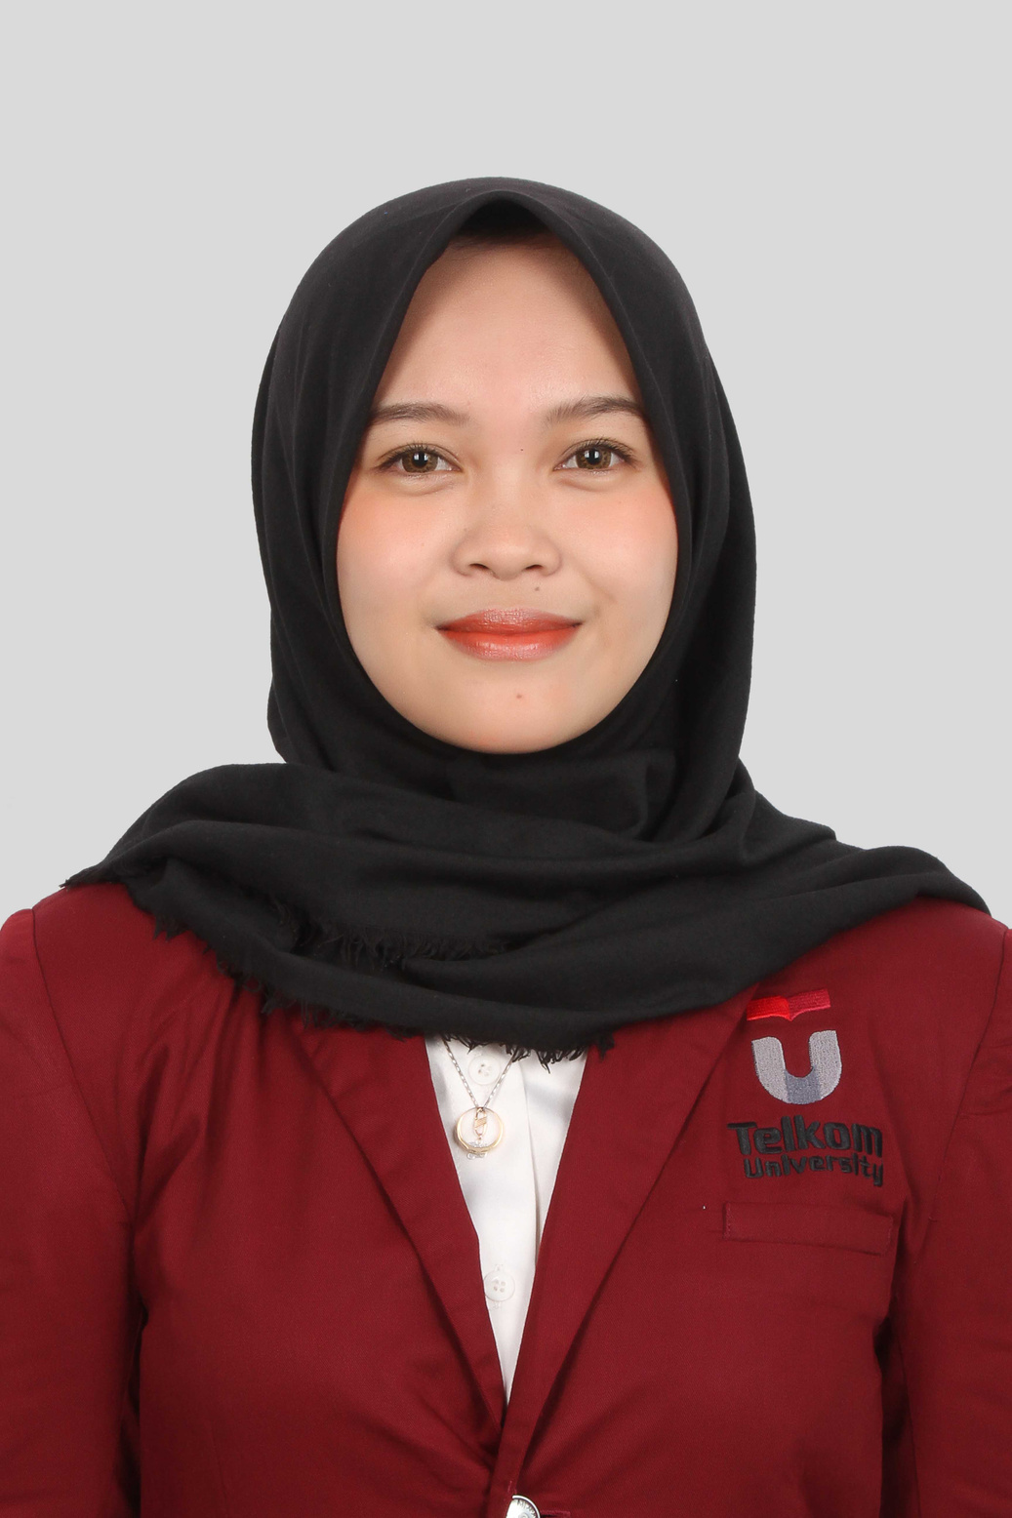

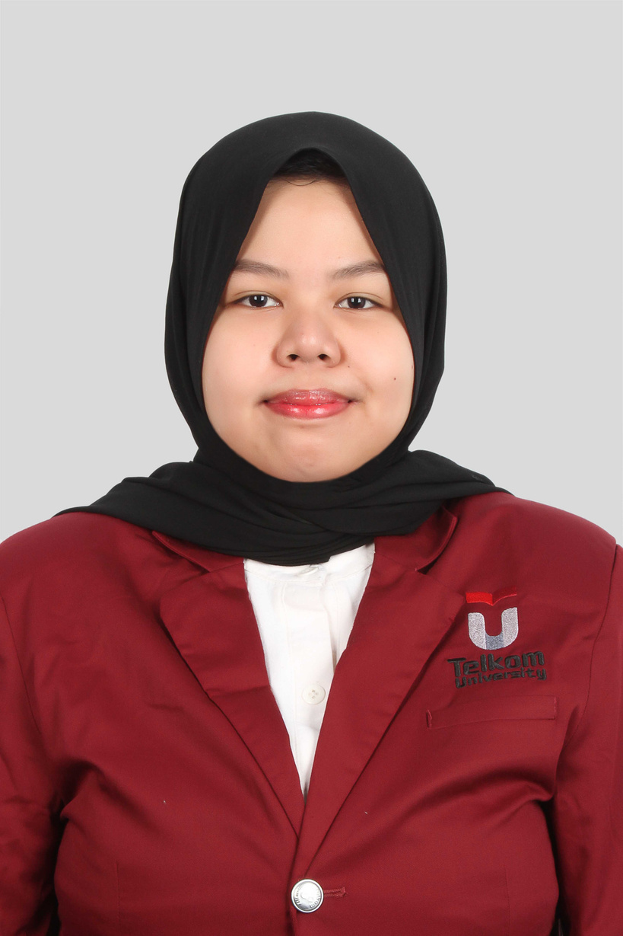
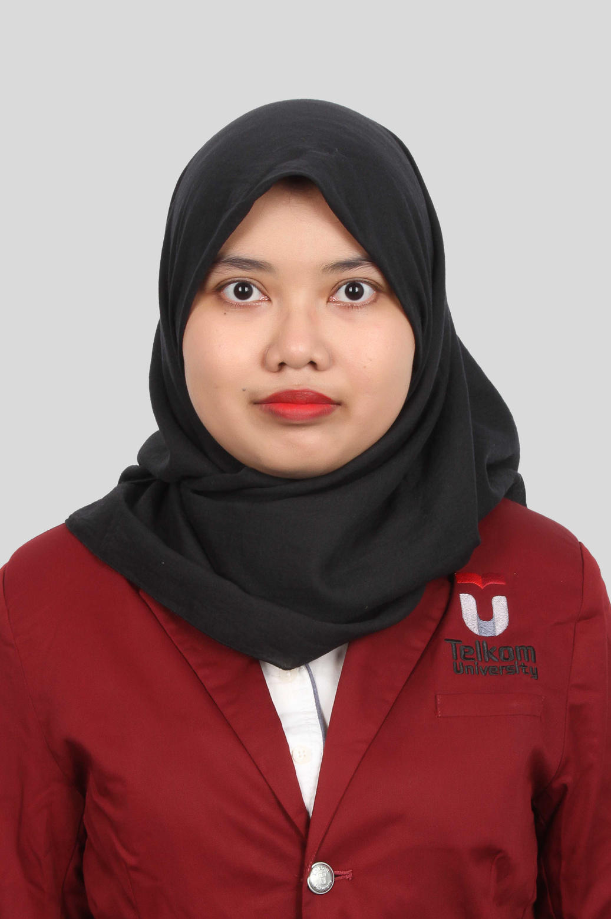
Our Team
Aulia Chusnyriani Sani Zulkarnaen
I Gusti Ngurah Rejski Ariantara P
Nada Fauzia Reviana
Rahmawati Hidayah
1101194043
1101190017
1101194198
1101194070

Slide 3

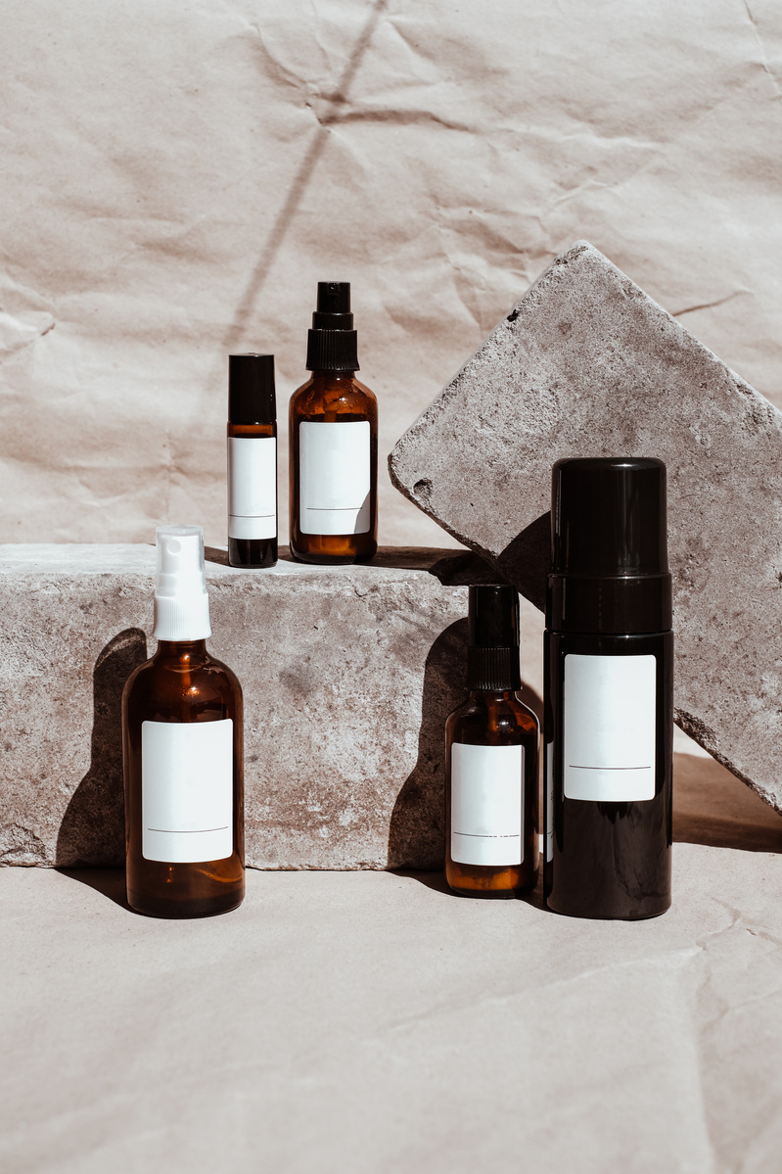
Table Of Contents
Introduction & Solution
System Design
Implementation
Testing and Analysis
Conclusion and Suggestion

Slide 4
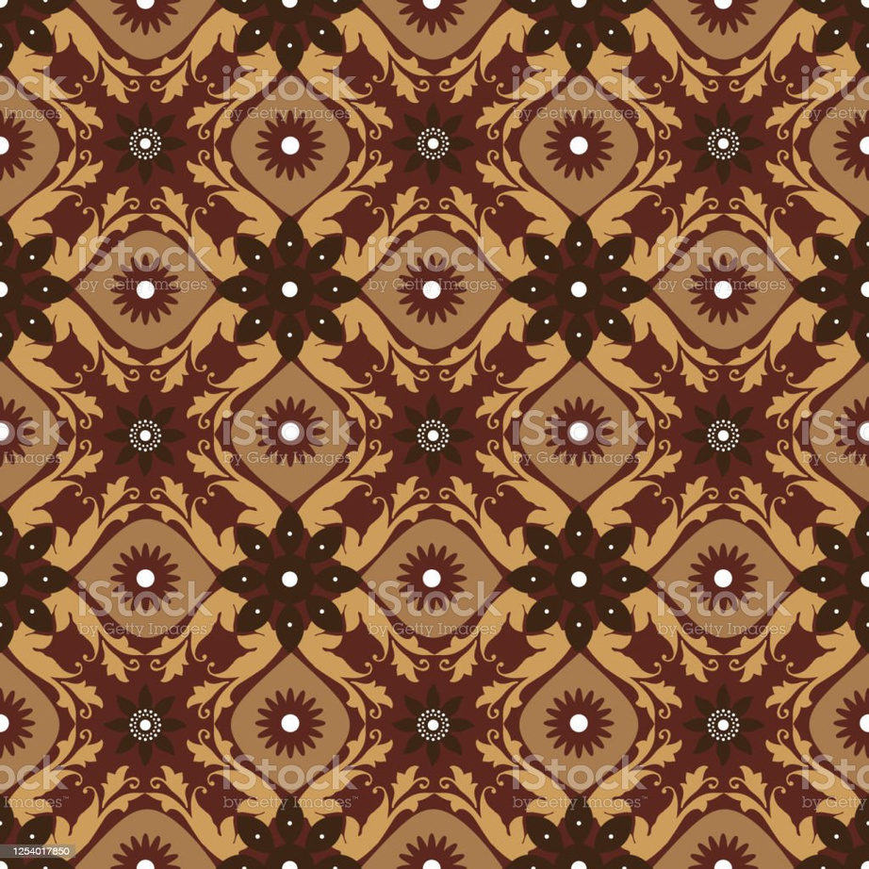
Introduction
•Batik is a traditional cloth and one of Indonesia's heritage. Batik comes from the Javanese word "amba" (to write) and "nitik" (to make dots).
•UNESCO has approved batik as an intellectual cultural right of the Indonesian people on October 2, 2009
•Batik motifs in Indonesia reach 5,849 batik motifs and are spread throughout Indonesia.
•Need a system that helps to classify batik types into certain classes.
•Using a Mobile Application that can be used anywhere and makes it easier for users.

Slide 5

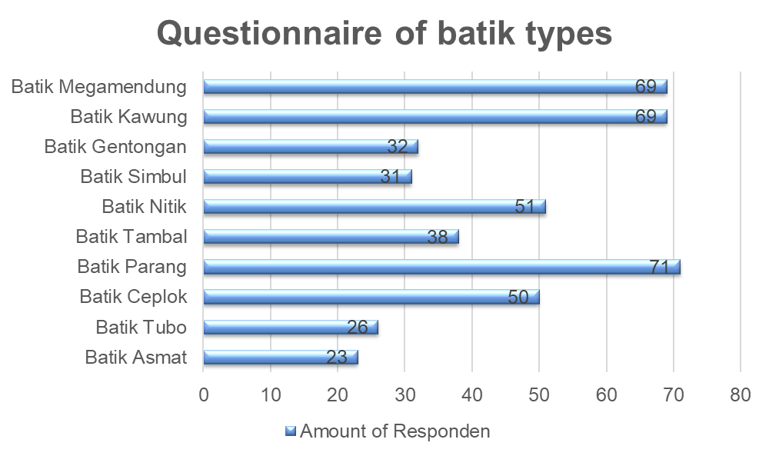
Introduction

Slide 6

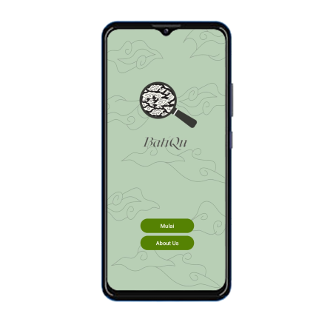
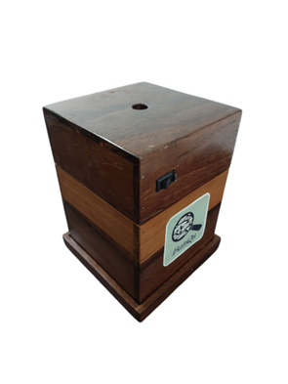
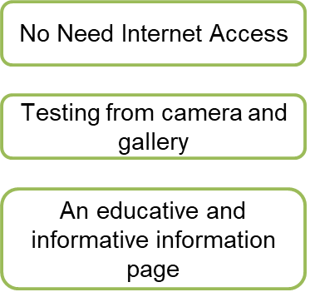
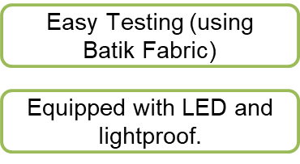
Solution

Slide 7
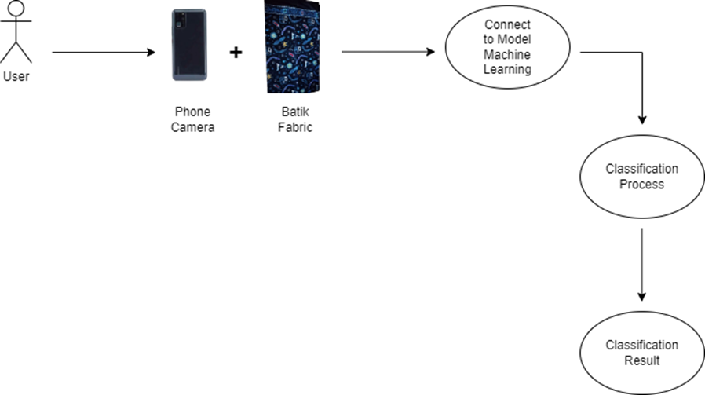
System Design

Slide 8
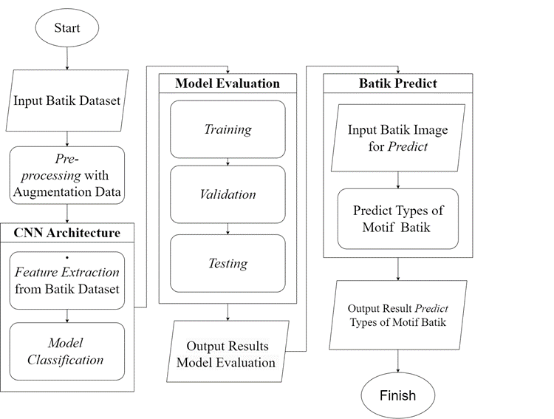
CNN System

Slide 9
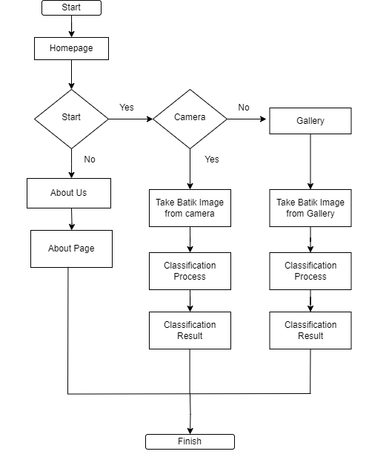
Mobile Application

Slide 10
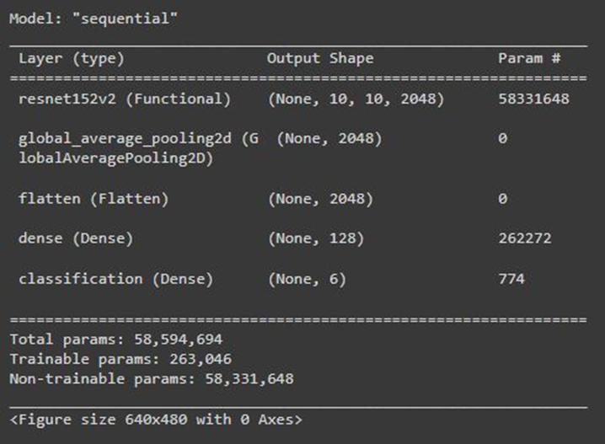
CNN
System
•Dataset: Using 660 batik images which are divided into 6 classes "Batik Megamendung", "Batik Kawung", "Batik Nitik", "Batik Parang", "Batik Ceplok" and "Batik Tambal".
•Architecture : ResNet152 V2 and MobileNet V1
•Evaluation: Accuracy reaches 90% and loss <0.1

Slide 11

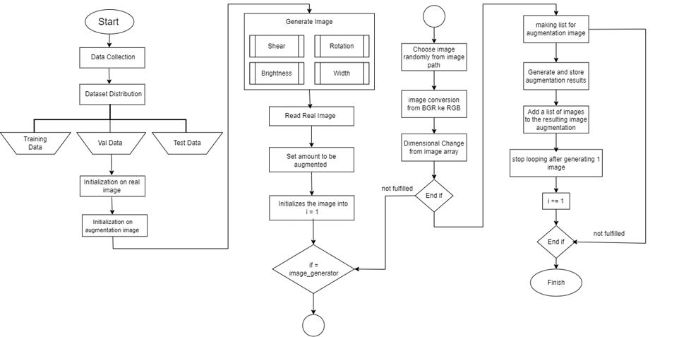
Augmentation

Slide 12
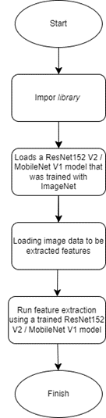
Feature
Extraction

Slide 13
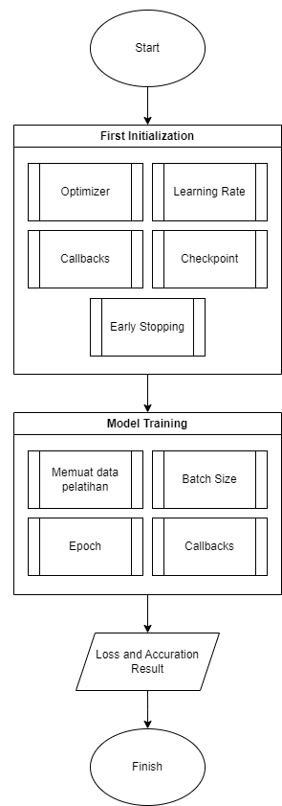
Classification

Slide 14

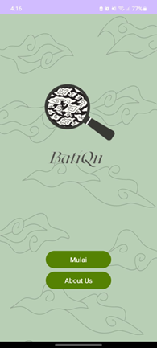
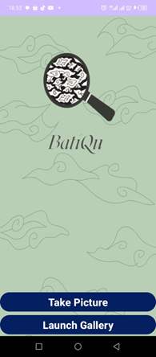
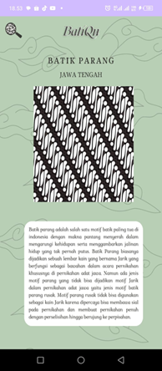
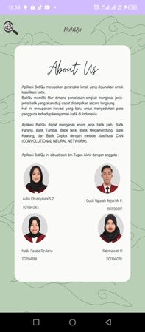
Mobile Application - BatiQu

Slide 15
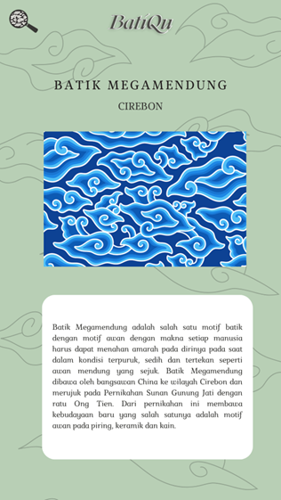
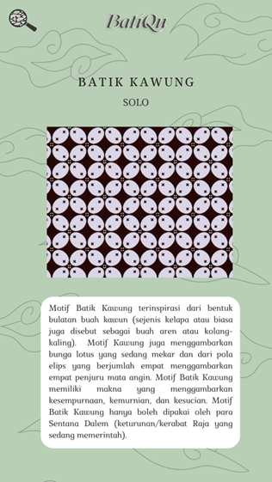
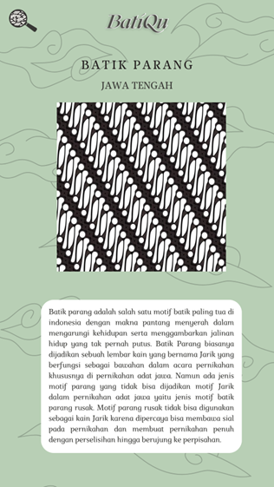
Mobile Application - BatiQu

Slide 16
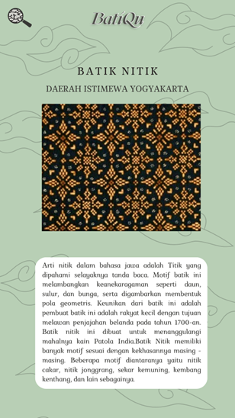
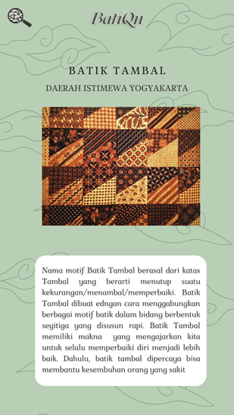
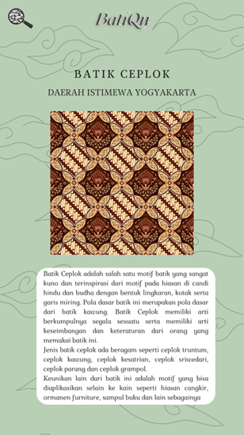
Mobile Application - BatiQu

Slide 17
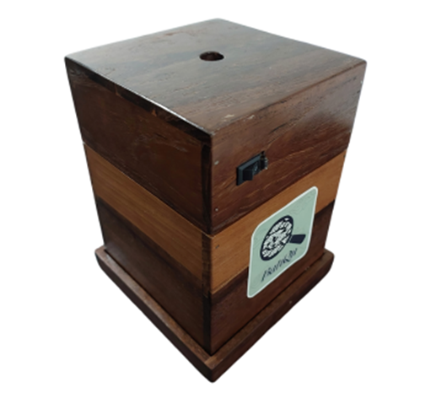
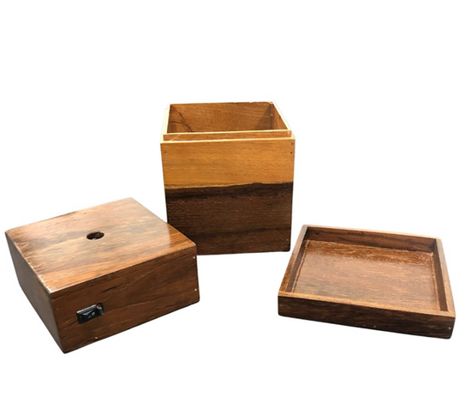
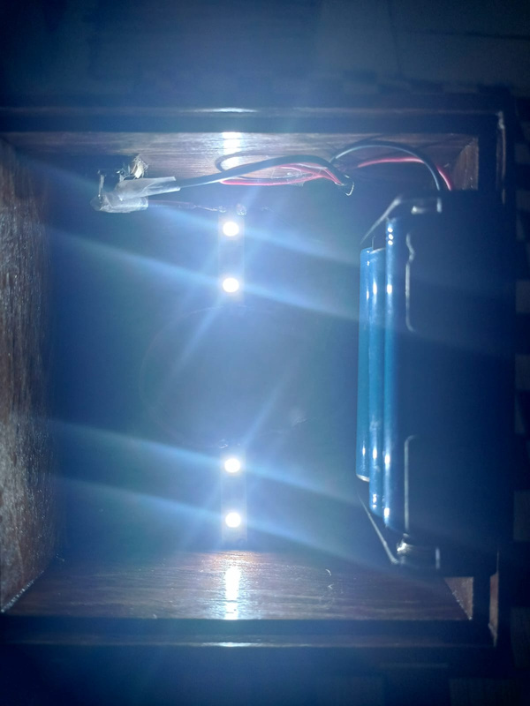
BatiQu Box
Final Result of Box
There are 3 parts that cosist of top, middle and bottom
Top part that contains LED series

Slide 18
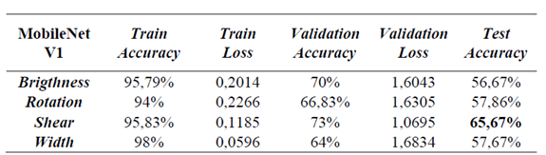
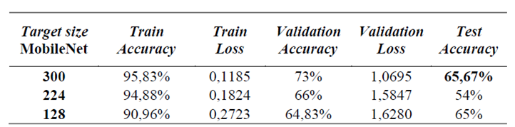
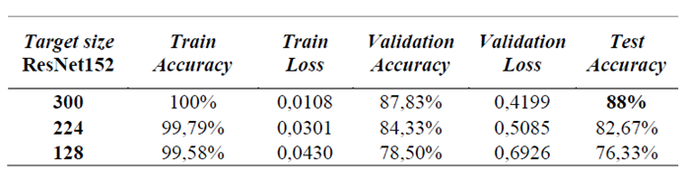
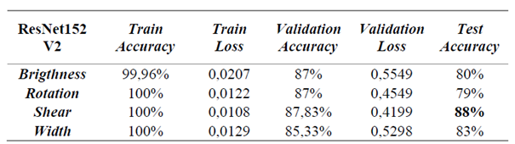
Testing - Processing
Pre - processing
Target Size

Slide 19
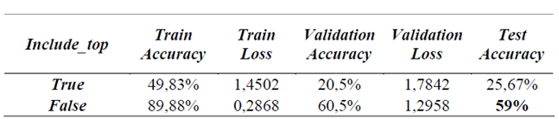
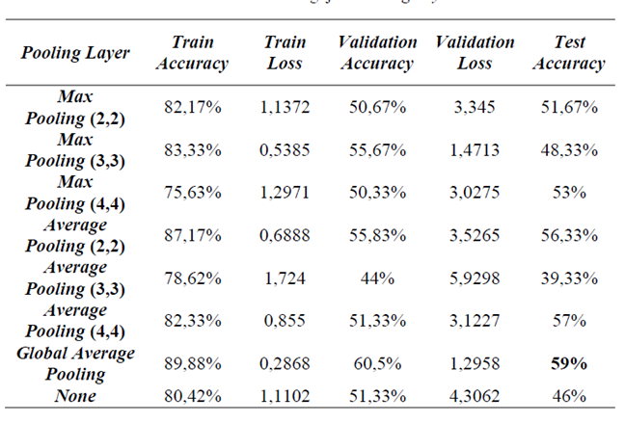
Testing - Feature Extraction
MobileNet V1
Pooling Layer
Include Top

Slide 20
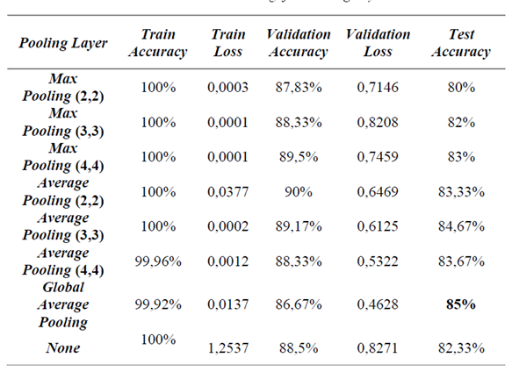
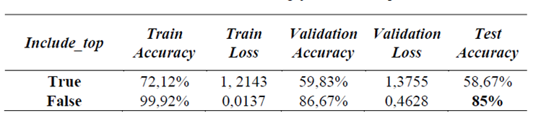
Testing - Feature Extraction
ResNet152 V2
Pooling Layer
Include Top

Slide 21
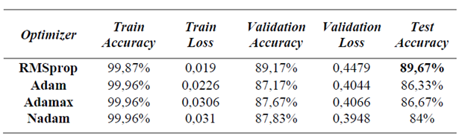
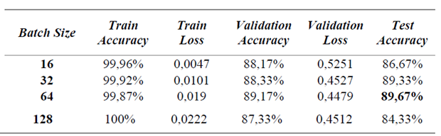
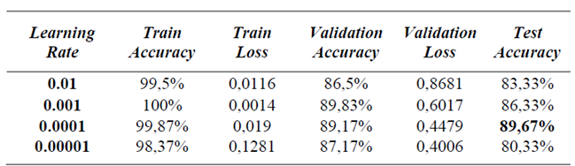
Testing - Classification
Optimizer
Batch Size
Learning Rate

Slide 22
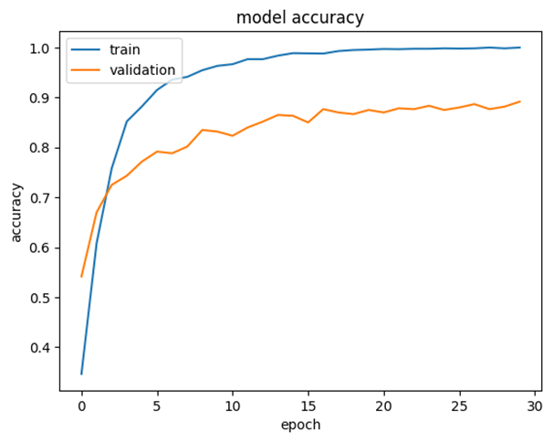
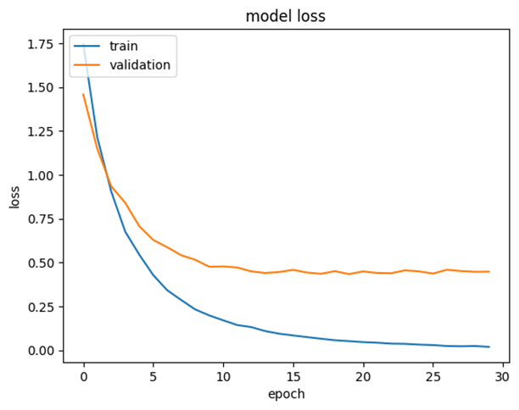
Classification Report

Slide 23
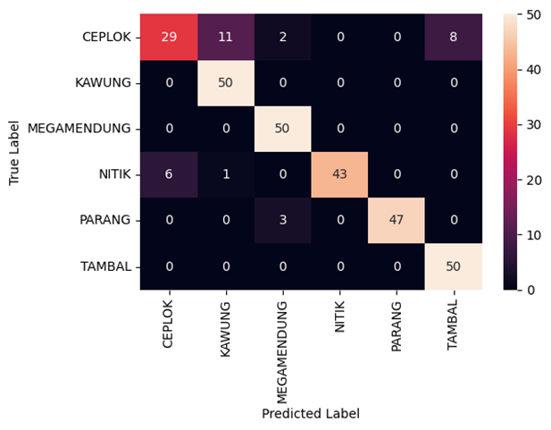
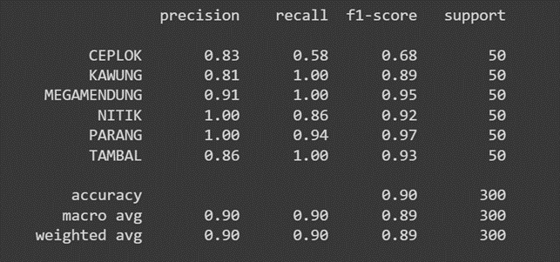
Classification Report

Slide 24
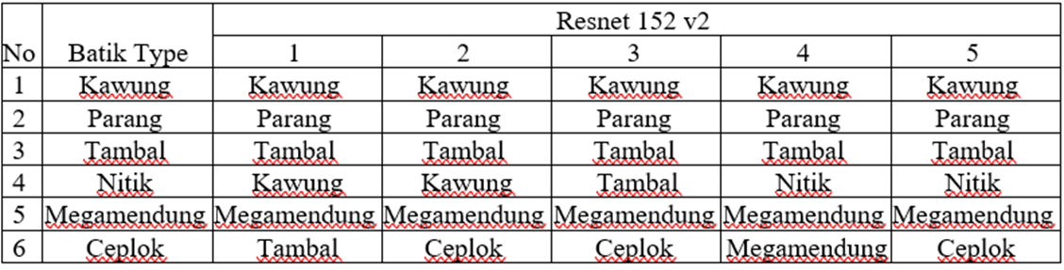
Testing - Mobile Application

Slide 25
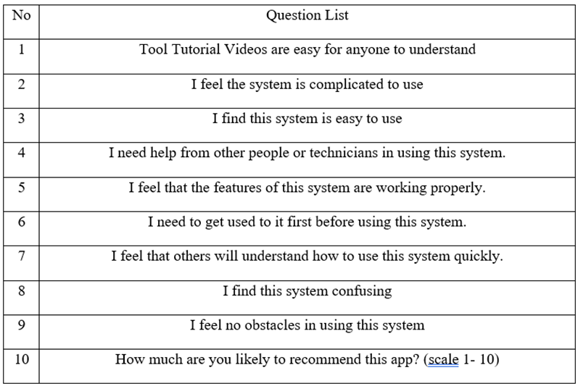
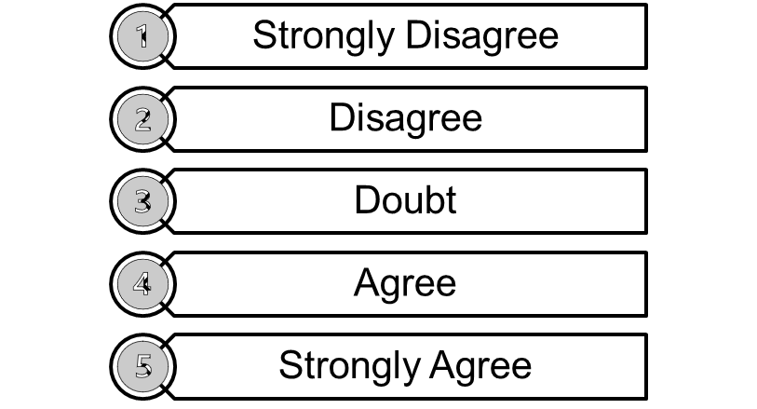
Testing - Mobile Application
System Usability Scale (SUS)

Slide 26
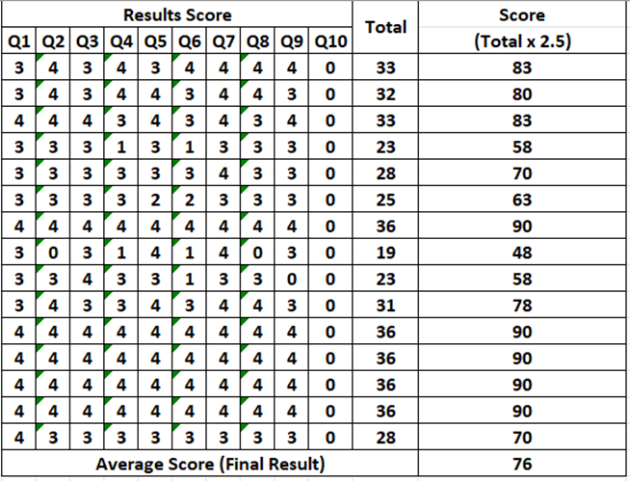
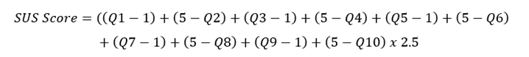

Testing - Mobile Application
System Usability Scale (SUS)

Slide 27

Conclusion
•The results of shear augmentation and target size 300 on the ResNet152 V2 architecture model have more optimal results compared to MobileNet V1.
•The CNN algorithm of the ResNet152 V2 architecture model can work well to classify batik type images with an accuracy of 85%.
•The ResNet152 V2 architecture model was chosen as the most optimal system model for Mobile Application because the accuracy result reached 89.67% on the RMSprop optimizer with a learning rate of 0.0001 and a batch size of 64.
•The performance of the BatiQu application can identify the type of batik even better if the position of the cloth and camera is correct.

Slide 28

Suggestion
1. Using more datasets with better image resolution, especially batik that is less known in the public so that the system model can learn more variations.
2. Using other pre-processing techniques so that system accuracy can be more varied.
3. Using other architecture models with various layer configurations.
4. Using a more varied optimizer
5. Adding maps feature as the origin of batik, and integrated to E-commerce and related articles.

Slide 29

Thank You
If there's any question, dont mind if ask to us

